Slide 1
Telephone Company Database Project
Prabhab Dewan [985955]
Rajesh Subedi [985709]
Shreedhar Acharya [985557]

Slide 2
Technologies Used
MSSQL SERVER 2008 R2
NodeJS server
HTML/CSS/JavaScript frontend
Report Builder 3.0

Slide 3
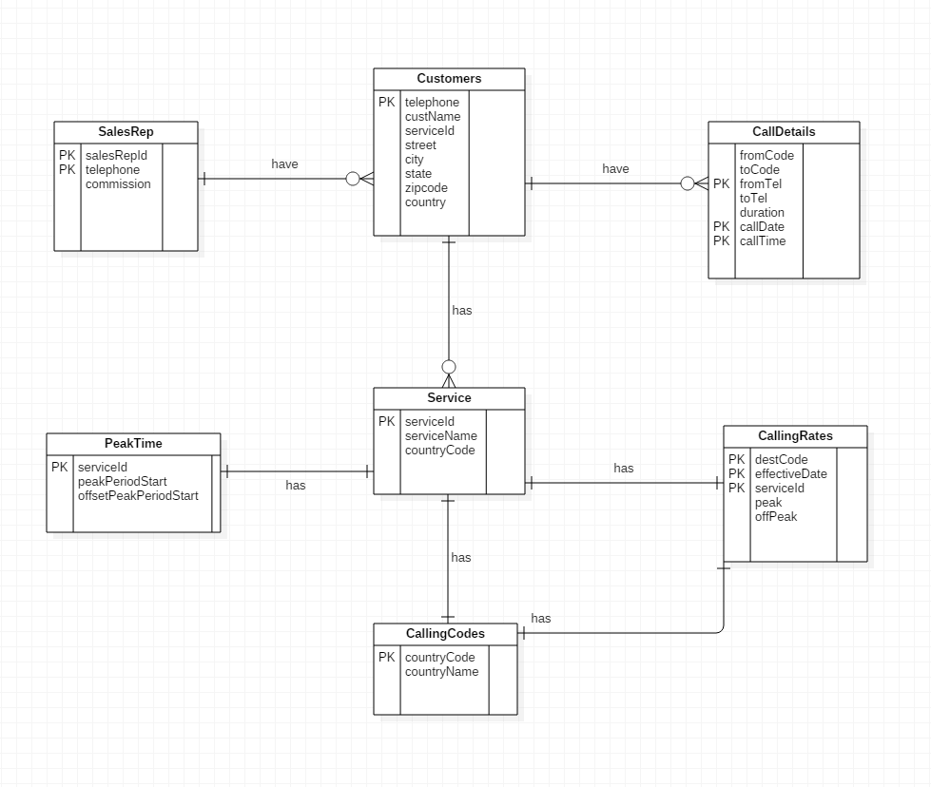
ER Diagram

Slide 4
Logical Database Design
Relation: Customers (custName, telephone, serviceId, street, city, state, zipcode, country)
Primary Key: telephone
Foreign Key: Foreign key serviceId references Service(serviceId)
Relation: SalesRep (salesRepId, telephone, commission)
Primary Key: salesRepId, telephone
Foreign key: Foreign key custName references Customers(custName)
Relation: CallDetails (fromCode, toCode, fromTel, toTel, duration, callDate, callTime)
Primary Key: fromCode, callDate, callTime
Foreign Key: Foreign key fromTel references Customers(telephone)
Relation: Service (serviceId, serviceName, countryCode)
Primary Key: serviceId
Foreign Key: Foreign key countryCode references CallingCode(countryCode)

Slide 5
Logical Database Design ctd..
Relation: CallingCodes (countryCode, countryName)
PrimaryKey: countryCode
Relation: PeakTime (serviceId, peakPeriodStart, offsetPeakPeriodStart)
Primary Key: serviceId
Foreign Key: Foreign Key serviceId references Service(serviceId)
Relation: CallingRates (destCode, effectiveDate, serviceId, peakRate, offPeakRate)
Primary Key: destCode, effectiveDate, serviceId
Foreign Key: Foreign key serviceId references Service(serviceId)
Foreign key destCode references CallingCode(countryCode)

Slide 6
Store Procedure
Create customer
Generate country codes
Generate call details
Updating call rates
Creating monthly traffic summary
Generating Customer monthly bill
Generating commissions
Generating rate sheets

Slide 7
Store Procedure ctd..
For Country Codes
CREATE PROCEDURE [dbo].[updateCountryCodes]
(@location varchar(200))
AS
BEGIN
DECLARE @SQL nvarchar(MAX)
SET @SQL =
'insert INTO CallingCodes(CountryName, CountryCode)
SELECT *
FROM OPENROWSET(
''Microsoft.ACE.OLEDB.12.0'',
''Excel 12.0;HDR=YES;Database=' + @location + ''',
''select * from [sheet1$]'')'
EXEC (@SQL)
END

Slide 8
Store Procedure ctd..
For Customer
CREATE PROCEDURE [dbo].[createCustomers]
(@location varchar(200))
AS
BEGIN
DECLARE @SQL nvarchar(MAX)
SET @SQL =
'insert INTO Customers
SELECT *
FROM OPENROWSET(
''Microsoft.ACE.OLEDB.12.0'',
''Excel 12.0;HDR=YES;Database=' + @location + ''',
''select * from [customers$]'')'
EXEC (@SQL)
END

Slide 9
Store Procedure ctd..
For Call Details
CREATE procedure [dbo].[createCallDetails]
@location varchar(200),
@sheet varchar(200)
as
begin
DECLARE @SQL nvarchar(MAX)
SET @SQL =
'insert INTO CallDetails
SELECT *
FROM OPENROWSET(
''Microsoft.ACE.OLEDB.12.0'',
''Excel 12.0;HDR=YES;Database=' + @location + ''',
''select * from ['+@sheet+'$]'')'
EXEC (@SQL)
end

Slide 10
Store Procedure ctd..
For updating call rates
CREATE PROCEDURE [dbo].[updaterate]
@location varchar(200),
@sheetname varchar(20),
@effectivedate varchar(20),
@serviceID varchar(10)
AS
BEGIN
DECLARE @SQL nvarchar(MAX)
SET @SQL =
'insert INTO dbo.CallingRates
SELECT A.dest, ''' + @effectivedate + ''', '''+@serviceID+''', A.peak, A.offpeak
FROM OPENROWSET(
''Microsoft.ACE.OLEDB.12.0'',
''Excel 12.0;HDR=YES;Database=' + @location + ''',
''select * from [' + @sheetname + '$]'')as A'
EXEC (@SQL)
END

Slide 11
Store Procedure ctd..
For Generating rate sheets
ALTER procedure [dbo].[genetateRatesSheet]
@serviceid int,
@yearmonth varchar(10)
AS
BEGIN
select s.serviceName, (select c.countryName from CallingCodes c where c.countryCode= destCode)as destCountry ,cr.effectiveDate,pt.peakPeriodStart,cr.peakRate,pt.offsetPeakPeriodStart,cr.peakRate
from Service s
join PeakTime pt on(s.serviceId=pt.serviceId)
join CallingRates cr on(cr.serviceId=s.serviceId)
Where cr.effectiveDate =(select MAX(cr2.effectiveDate) from CallingRates cr2 where CONVERT(VARCHAR(7), cr2.effectiveDate, 120)<=@yearmonth and s.serviceId= @serviceid )
END

Slide 12
Store Procedure ctd..
For Monthly Traffic Summary
CREATE PROCEDURE [dbo].[monthlyTrafficSummary]
@yearmonth varchar(10)
AS
BEGIN
select s.serviceName,
(select cn.countryName from CallingCodes cn where cn.countryCode=cd.fromCode)as From_Country,
(select cn.countryName from CallingCodes cn where cn.countryCode=cd.toCode)as To_Country,
SUM(cd.duration) as Total_Duration
from CallDetails cd join
Customers c on(c.telephone=cd.fromTel and left(CONVERT(VARCHAR, cd.callDate, 120),7)= @yearmonth)
join Service s on (c.serviceId=s.serviceId)
join CallingCodes cc on(cc.countryCode=s.countryCode)
group by s.serviceName,cd.fromCode,cd.toCode
END

Slide 13
Store Procedure ctd..
For Monthly Customer Bill
ALTER PROCEDURE [dbo].[createBill]
@telephone bigint,
@yearmonth varchar(10)
AS
BEGIN
select t.toTelephone,t.destinationCountry,t.duration,t.Cost as totalAmt from
(select distinct cd.toTel as toTelephone,(select c.countryName from CallingCodes c where c.countryCode= cd.toCode)as destinationCountry,cd.duration,(cd.duration/60*(case when (
(select p.peakPeriodStart from PeakTime p where p.serviceId=s.serviceId)>=800
and (select p.peakPeriodStart from PeakTime p where p.serviceId=s.serviceId)<1700) then
(select cr1.peakRate from CallingRates cr1 where cr1.serviceId=s.serviceId and cr1.destCode=cd.toCode and cr1.effectiveDate=(select MAX(cr2.effectiveDate) from CallingRates cr2 where CONVERT(VARCHAR(7), cr2.effectiveDate, 120)<=@yearmonth))
else (select cr1.offPeakRate from CallingRates cr1 where cr1.serviceId=s.serviceId and cr1.destCode=cd.toCode and cr1.effectiveDate=(select MAX(cr2.effectiveDate) from CallingRates cr2 where CONVERT(VARCHAR(7), cr2.effectiveDate, 120)<=@yearmonth)) end ))as Cost
from Customers c
join CallDetails cd on(c.telephone=cd.fromTel and left(CONVERT(VARCHAR, cd.callDate, 120),7)=@yearmonth)
join Service s on(c.serviceId=s.serviceId)
join CallingRates cr on(s.serviceId=cr.serviceId )
where c.telephone=''+@telephone+'') as t
END

Slide 14
Store Procedure ctd..
For sale representative commission
ALTER procedure [dbo].[calculateCommission]
@yearmonth varchar(10)
AS
BEGIN
select sr.salesRepId, sum(t1.custCost*sr.salesRepId*0.01) as totalCommission from
(select t.custName,telephone, SUM(t.costpercall/60) as custCost from
(select distinct custName,telephone, (cd.duration*(case when (
(select p.peakPeriodStart from PeakTime p where p.serviceId=s.serviceId)>=800
and (select p.peakPeriodStart from PeakTime p where p.serviceId=s.serviceId)<1700) then
(select cr1.peakRate from CallingRates cr1 where cr1.serviceId=s.serviceId and cr1.destCode=cd.toCode and cr1.effectiveDate=(select MAX(cr2.effectiveDate) from CallingRates cr2 where CONVERT(VARCHAR(7), cr2.effectiveDate, 120)<=@yearmonth))
else (select cr1.offPeakRate from CallingRates cr1 where cr1.serviceId=s.serviceId and cr1.destCode=cd.toCode and cr1.effectiveDate=(select MAX(cr2.effectiveDate) from CallingRates cr2 where CONVERT(VARCHAR(7), cr2.effectiveDate, 120)<=@yearmonth)) end ))as costpercall
from Customers c
join CallDetails cd on(c.telephone=cd.fromTel and left(CONVERT(VARCHAR, cd.callDate, 120),7)=@yearmonth)
join Service s on(c.serviceId=s.serviceId)
join CallingRates cr on(s.serviceId=cr.serviceId )) as t
group by t.custName,t.telephone) as t1 join SalesRep sr on(t1.telephone=sr.telephone)
group by sr.salesRepId;
END

Slide 15
JAY GURUDEV

Slide 16
DEMO

